Slide 1
Engine Fuel Consumption System Prepared By Mayuri Kadam

Slide 2
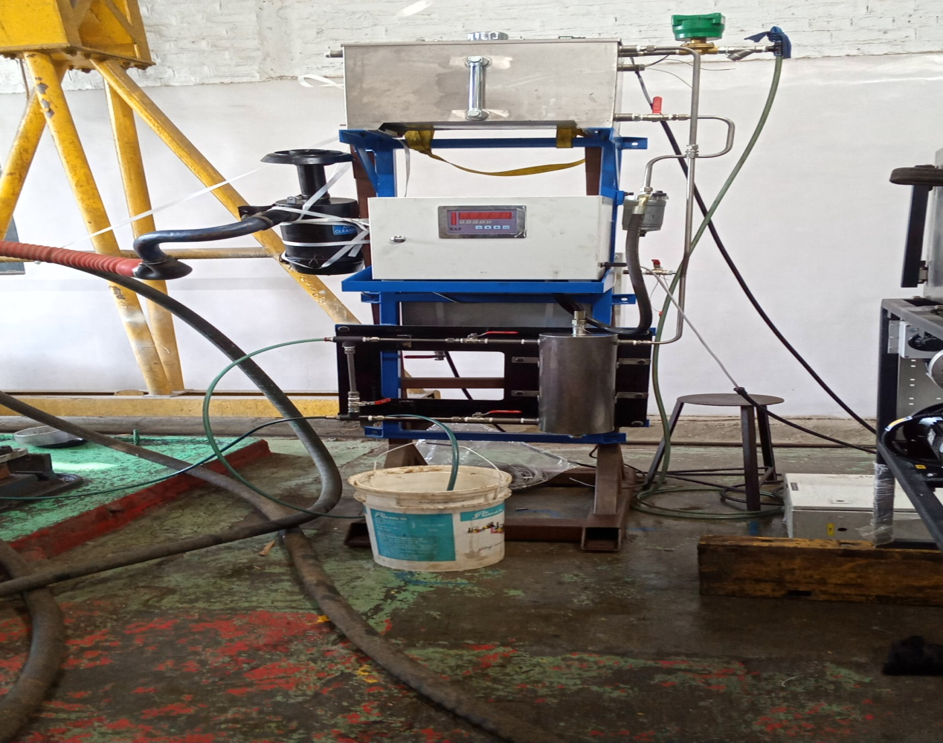
Gravimetric Fuel Consumption system

Slide 3
Mechanical Units
Header Tank
It is used as Fuel Tank
Fuel In solenoid Valve
This is used for allowing fuel into Header tank it is always Normally close type that means whenever we will give supply to this valve then it will get open & fuel enter in Tank
Level Switch(Float Switch)
Level switch is used for getting fuel level in Tank like Low & High Level

Slide 4
Level switch has potential free contact as well as reed switch for sensing levels.
When there is no fuel in tank or small amount of fuel in tank then it will give contact output so that we can understand low level of fuel
When tank is full with fuel then level switch will sense high level of tank.
As soon as low level sense by level switch Fuel solenoid will gets ON & fuel filling start
When High level reached & sense by level switch same time Fuel solenoid get OFF.

Slide 5
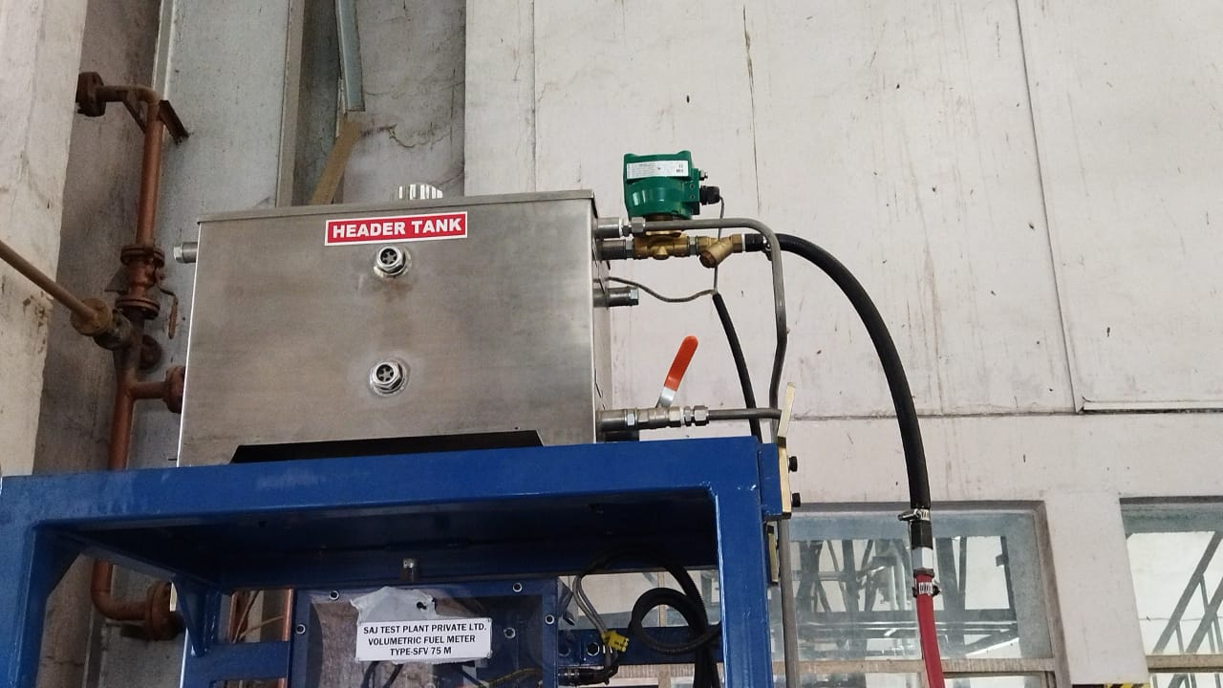
HEADER TANK LOGIC

Slide 6
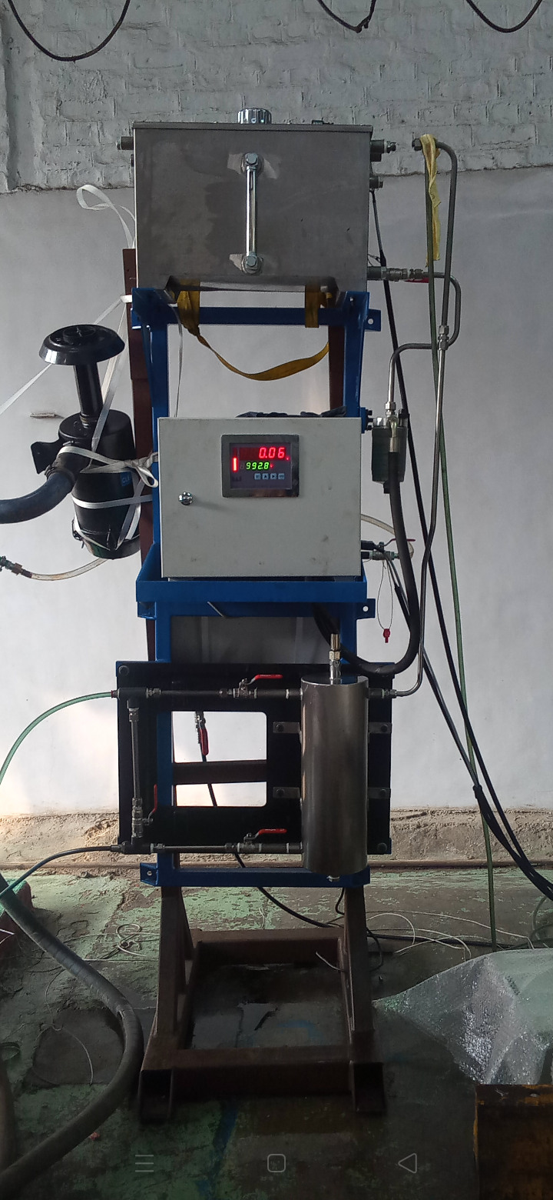
FCM UNIT

Slide 7
IN FCM unit fuel flow rate measured in kg/hr in terms of gram
At each test cycle points of speed & Torque ,this unit give us fuel flow rate in kg/hr

Slide 8
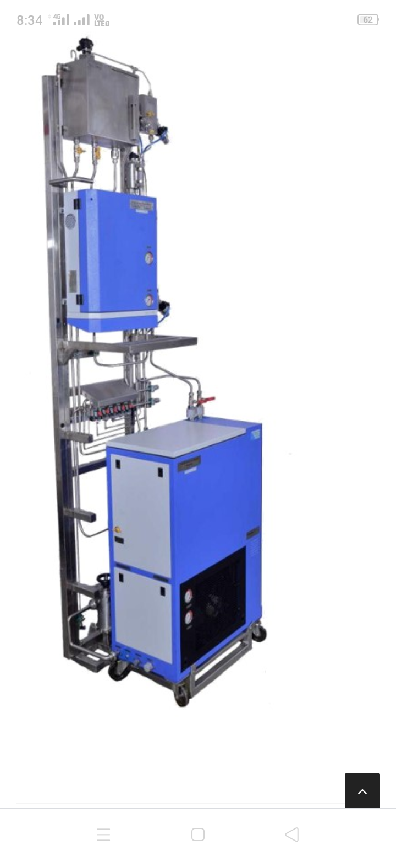
Fuel Temperature Controller Unit

Slide 9
PURPOSE
The Fuel conditioning system is aimed to maintain temperature ,flow rate & pressures of fuel going to engine constant at set value .
System controls temperature of fuel supplied to the engine either by indirect cooling or heating .
The Fuel coming from FCM unit is added to fuel from return line of Engine & passes through a heat Exchanger .
A process controller maintains the set temperature for example 40℃ set point ,pressure of fuel at set temperature is supplied to the Engine. The fuel going to Engine is always in excess .Hence this Excess amount of fuel is bypassed & sent to the air separator along with the return line fuel coming from the engine.

Slide 10
Effect of Fuel Temperature
The performance levels of diesel Engines are influenced by a changing fuel Inlet temperature .
With high fuel temperature it causes high injection pressure resulting in shorter ignition delays which ultimately affect Engine Performance

Slide 11
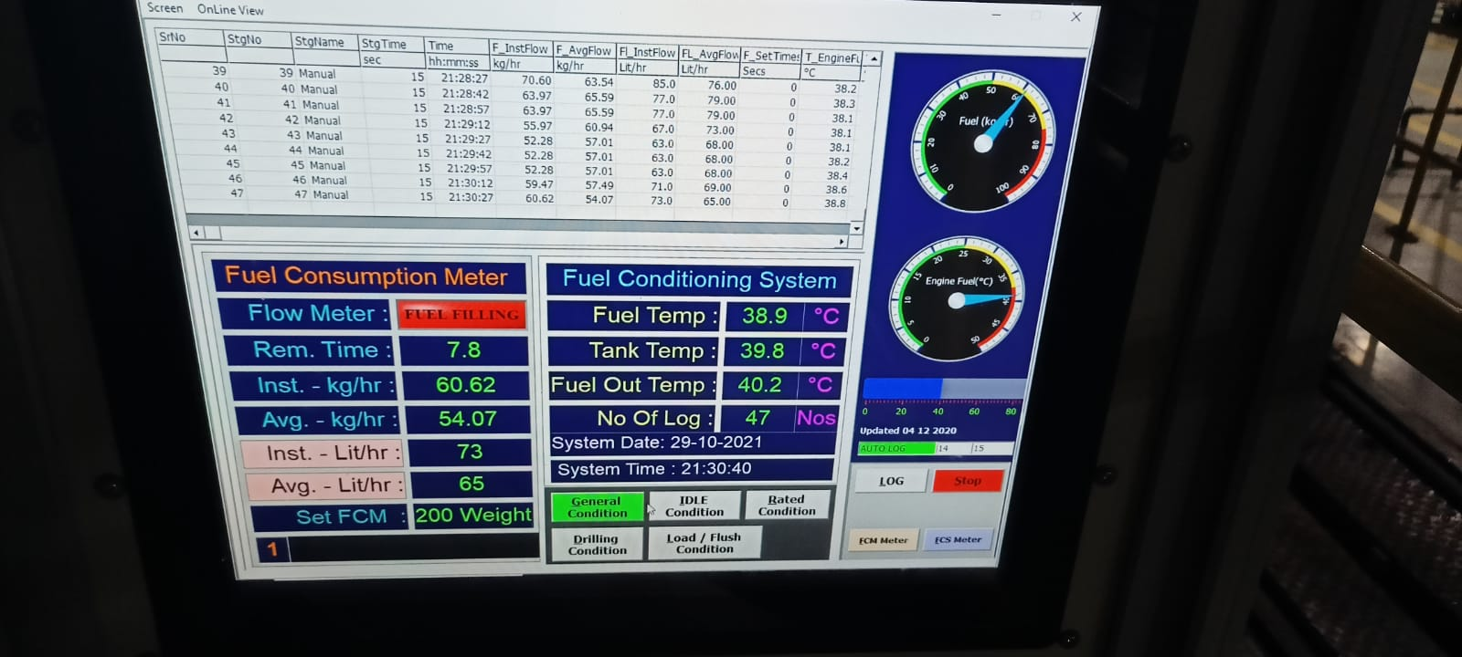
Engine Testing with FCM UNIT & FTC UNIT

